Slide 1


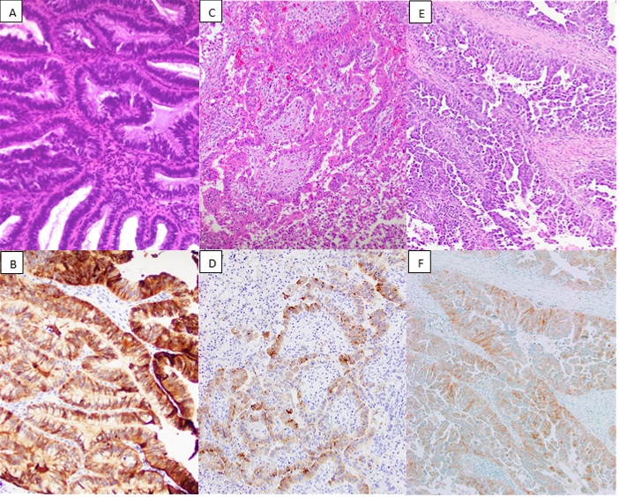

Immunohistochemical Evaluation of FGFR2b and FGFR3 in Gynecologic Malignancies: Correlation with Molecular Status
Yasamin Mirzabeigi¹ MD, Andre Pinto¹ MD
¹Department of Pathology and Laboratory Medicine, University of Miami Miller School of Medicine, Miami, Florida
Results
Fibroblast growth factor receptors (FGFRs) comprise a family of four transmembrane tyrosine kinase receptors (FGFR1–FGFR4) involved in cell proliferation, differentiation, and survival. Alterations in FGFR signaling have been identified in approximately 10% of gynecologic carcinomas.
FGFR inhibitors have demonstrated promising therapeutic activity across multiple solid tumors with FGFR alterations, suggesting the potential for targeted therapy in carcinomas of the gynecologic tract.
Immunohistochemistry (IHC) may serve as an accessible and cost-effective screening tool to identify patients eligible for FGFR-directed therapy. However, the correlation between FGFR molecular alterations and protein expression in gynecologic tumors has not been well-established to date.
  Among the 47 gynecologic carcinomas, FGFR2b protein overexpression was observed in 6/12 (50%) FGFR2-altered tumors compared with 8/35 (23%) non-FGFR2 tumors (Odds Ratio= 3.38).
  Although this reflects a trend toward increased positivity in FGFR2-altered cancers, the association was not statistically significant (Fisher’s Exact Test p-value= 0.14) and did not correlate with the type of FGFR alterations (mutations, amplifications, fusions and those with intermediate results).
  FGFR3 IHC positivity showed a stronger and statistically significant association with FGFR3 alteration, occurring in 3/7 (43%) FGFR3-altered tumors versus 2/40 (5%) malignancies with wild-type FGFR3 (Odds Ratio= 14.25; Fisher’s Exact Test p-value=0.019).
  FGFR1-altered tumors showed no clear relationship with either FGFR2b or FGFR3 IHC positivity.
  Benign proliferative and secretory endometrium demonstrated consistent physiologic FGFR2b positivity in 8/8 (100%) cases, whereas FGFR3 IHC was negative in all benign controls.
Introduction
Molecular Alteration | Positive FGFR2b IHC (≥2+) | Negative FGFR2b IHC (0/1+) | Fisher’s Exact Test p-value
FGFR2 Altered (n=12) | 6 (50%) | 6 (50%) | p=0.14
FGFR2 Wild Type (n=35) | 8 (22.9%) | 27 (77.1%)
Molecular Alteration | Positive FGFR3 IHC (≥2+) | Negative FGFR3 IHC (0/1+) | Fisher’s Exact Test p-value
FGFR3 Altered (n=7) | 3 (43%) | 4 (57%) | p=0.019
FGFR3 Wild Type (n=40) | 2 (5%) | 38 (95%)
Retrospective review of 585 molecularly sequenced gynecologic malignancies yielded the selection of 30 cases with FGFR1 (n=11), FGFR2 (n=12), or FGFR3 (n=7) alterations, including pathogenic mutations, amplifications, fusions and those with intermediate results.
Seventeen FGFR wild-type gynecologic carcinomas (NGS-confirmed) were randomly selected to serve as a cancer control group.
Twenty non-neoplastic gynecologic tract samples were included to assess physiologic expression (endometrium n=8, fallopian tube n=4, ovary n=3, cervix n=5).
IHC for FGFR2b and FGFR3 was performed on whole tissue sections and assessed for distribution (<5%, 5–50%, >50%) and intensity (+1, +2, +3). IHC positivity was defined as ≥2+ membranous staining in ≥5% of tumor cells.
Statistical analysis was performed using Fisher’s exact test, with p < 0.05 considered significant.
Methods
FGFR2b overexpression is more common in FGFR2-altered tumors; however, it does not demonstrate a statistically significant association, as FGFR2b can also be expressed in FGFR wild-type carcinomas and normal endometrium.
FGFR3 IHC is specific (albeit not sensitive) and showed strong and statistically significant correlation with FGFR3 alteration, while FGFR2b is more sensitive and demonstrated a positive but non-significant association with FGFR2 alteration.
Conclusion
References
(A) Ovarian high-grade serous carcinoma (H&E, 20×) with FGFR3::TACC3 fusion, showing strong (3+) FGFR3 membranous staining (B); (C) carcinosarcoma (H&E, 10×) with FGFR3::TACC3 fusion and (2+) FGFR3 immunostaining (D); (E) Endometrial serous carcinoma (H&E, 10×) with FGFR2 alteration exhibiting moderate (2+) FGFR2b membranous positivity (F).
Gatius S, Velasco A, Azueta A, Santacana M, Pallares J, Valls J, Dolcet X, Prat J, Matias-Guiu X. FGFR2 alterations in endometrial carcinoma. Mod Pathol. 2011 Nov;24(11):1500-10. doi: 10.1038/modpathol.2011.110. Epub 2011 Jul 1. PMID: 21725289.
Jafari P, Forrest ME, Segal J, Wang P, Tjota MY. Pan-Cancer Molecular Biomarkers: Practical Considerations for the Surgical Pathologist. Mod Pathol. 2025 Jun;38(6):100752. doi: 10.1016/j.modpat.2025.100752. Epub 2025 Mar 7. Erratum in: Mod Pathol. 2025 Jun;38(6):100773. doi: 10.1016/j.modpat.2025.100773. PMID: 40058460

